Slide 1


Evaluating Query Engines for SQL on top of anything
Vasileios Dimakopoulos IT-DB-SAS
May 20, 2019

Slide 2
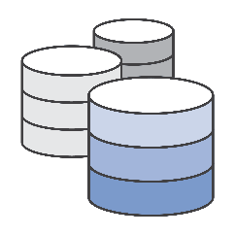
OUTLINE
Introduction
Motivation & Goals
Architecture
Plan for the evaluation of the technologies
Conclusions & Summary
Next Steps
Challenges
Aspects to be evaluated
Technologies’ Features & Limitations
Installation & Testing
Open Source vs Close Source Technologies
Section Meeting - May 20, 2019 - Vasileios Dimakopoulos 2

Slide 3
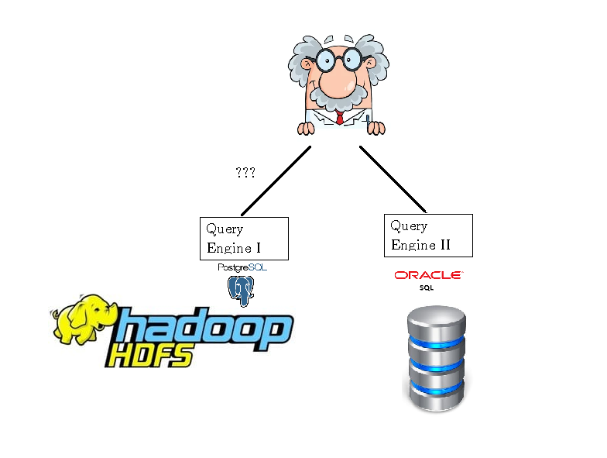

INTRODUCTION – Motivation & Goals
The project aims at offering a unified way to access data with SQL for analytic purposes in various different data store. (SQL on anything)
WHY?
Data Growing in HEP community
Salability limitations of Traditional Storage Systems
Need for Interactive Analysis
Heterogeneous environment (different systems )
Bind the systems with the data using common layer (business continuity)
Shift to Big Data Technologies
SQL On Anything
Unified Query Processing
Section Meeting - May 20, 2019 - Vasileios Dimakopoulos 3

Slide 4
INTRODUCTION – Project outline
1) Explore and select a candidate set of technologies which could follow suit the future advancements in the Big Data Community (Q2 2019)
Explore what is available on the market
Pick technologies that satisfy our requirements (see next slides)
2) Evaluate chosen technologies (Q2-Q4 2019)
Deployment, integration, performance etc.
3) Design a prototype system (Q4 2019)
4) Implement it (Q1 2020)
Section Meeting - May 20, 2019 - Vasileios Dimakopoulos 4

Slide 5
INTRODUCTION - Challenges
Select the technology which could follow suit the future advancements in the Big Data Community
Variety of query engines available
Choose the optimal to satisfy our use cases
Genericity vs specialization and performance
Single or a stack of technologies?
Keep the architecture/service simple in order to maintain it easily
Make it simple for the users as well
SQL on anything Service
Complexity
Suitability
Reliability
Scalability
Maintenance
Performance
Section Meeting - May 20, 2019 - Vasileios Dimakopoulos 5

Slide 6
INTRODUCTION – Aspects to be evaluated
Open source
Data Formats and Data Storage supported
JDBC Driver
Multitenancy (multiple users support, resource management per user/group and authorization)
Deployment Complexity
Performance (execution of typical benchmarks e.g. TPC-DS, query existing data)
Community Size
Fault Tolerance
Support of nested structures
Support for data modification (Insert and Update )
Section Meeting - May 20, 2019 - Vasileios Dimakopoulos 6

Slide 7


















INTRODUCTION - Open Source vs Close Source Technologies
Open Source
Close Source
Section Meeting - May 20, 2019 - Vasileios Dimakopoulos 7

Slide 8




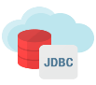








ARCHITECTURE– 3 or 2 logical layers
SQL
Top Abstraction Layer
Can schedule SQL to all data access layers or directly storage
Data Storage Layer
Top Abstraction Layer
Specialized technology that is able to query efficiently the storage
Data Access Layer
Data Storage Layer
Do we need 3 layers? Two might be enough if the top level one can access all required storages
Section Meeting - May 20, 2019 - Vasileios Dimakopoulos 8

Slide 9
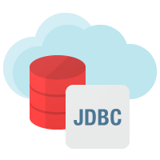




ARCHITECTURE
SQL
Data Storage Layer
Data Access Layer
Top Abstraction Layer
Section Meeting - May 20, 2019 - Vasileios Dimakopoulos 9

Slide 10
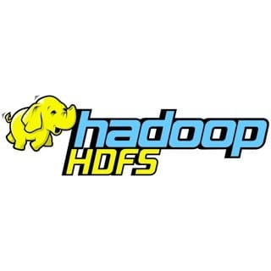





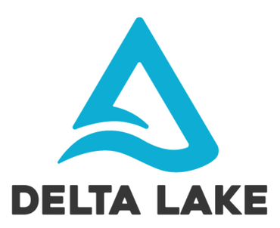
Storage Layer
HDFS
For analytics and reporting
Parquet, CSV, JSON
Parquet vs ORC? – to be evaluated
Hudi vs Delta Lake?
HBase
For low latency big database– OLTP-like
Kafka
For low data latency streaming data access
RDBMS – real OLTP
Oracle
MySQL
PostgreSQL
Others ?
Section Meeting - May 20, 2019 - Vasileios Dimakopoulos 10

Slide 11
ARCHITECTURE
SQL
Data Storage Layer
Data Access Layer
Top Abstraction Layer
Section Meeting - May 20, 2019 - Vasileios Dimakopoulos 11

Slide 12

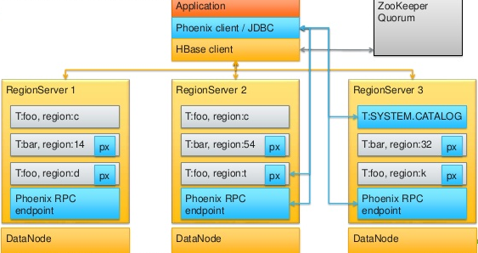
TECHNOLOGIES – Features & Limitations
Future reach SQL layer on top of HBase
selection, aggregation, range scans
insert, update, deletion of rows
Build-in query optimizer
JDBC Support, direct or via proxy server
Multi tenant environment (schemas, grants etc)
Nested Structures Supported
Apache Phoenix ‘s Community: 81 contributors More than 50 commits the last 3 months
Adopted by Cloudera and Hortonworks
Is Phoenix suitable for the architecture?
Easy to deploy (single jar on HBase classpath)
Mature and optimized - leverages the horizontal scalability of HBase with server side executions
Seems to be the most popular SQL on HBase solution
Could interoperate well with the 3rd layer: Drill (Drillix) and Presto (MR opened) or JDBC
Transactions (beta)
Secondary indexes (beta)
Not suitable for big analytics (joins over large data sets)
No PL/SQL support
Section Meeting - May 20, 2019 - Vasileios Dimakopoulos 12

Slide 13
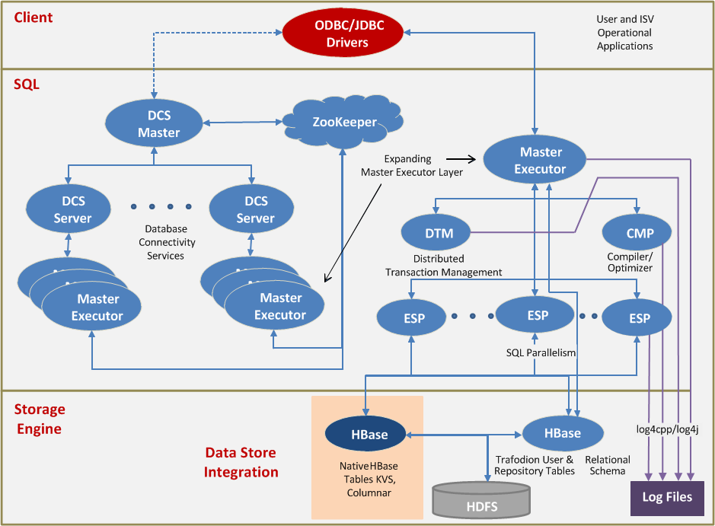

TECHNOLOGIES – Features & Limitations
Apache Trafodion is SQL-on-Hadoop solution enabling transactional or operational workloads on “Hadoop” – abstraction on top of HBase.
JDBC Support and ACID transactions
Optimizes query execution for large datasets using parallel query optimizer ???
Apache Trafodion’s community: 72 contributors Around 50 commits the last 3 months
Is Trafodion suitable for the architecture?
Provides a relational schema abstraction on top of HBase
SQL queries are flowing entirely through memory (SQL on Big Data: Technology, Architecture, and Innovation Book*)
Does not have a dedicated integrations with higher layers (just JDBC)
Quick data look up might not be fast??
Section Meeting - May 20, 2019 - Vasileios Dimakopoulos 13

Slide 14

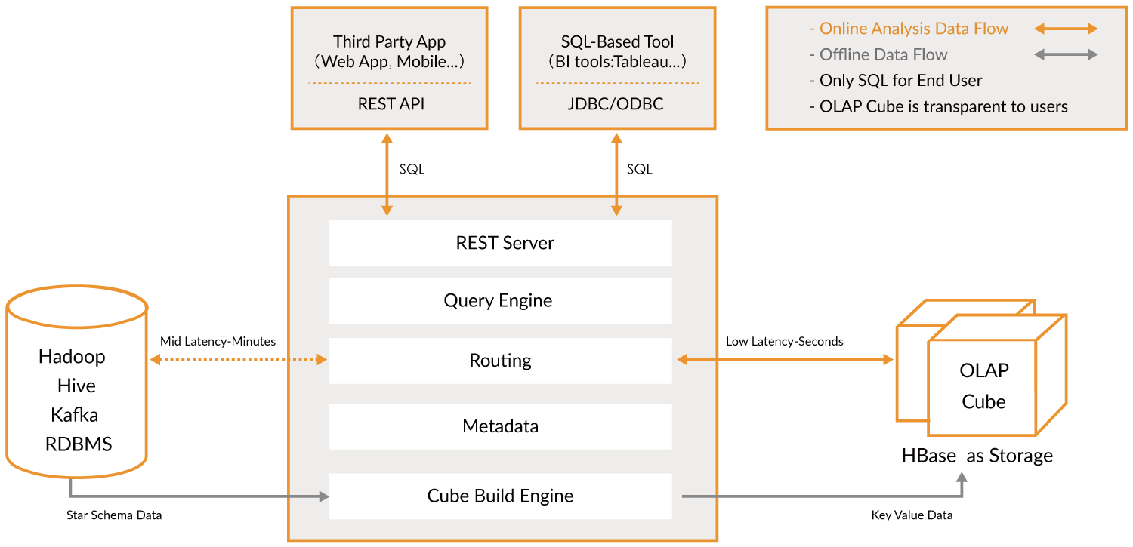
TECHNOLOGIES – Features & Limitations
Distributed Analytics Engine on Hadoop/Spark
Claimed to have sub-second latency, JDBC support
Uses HBase as storage (OLAP Cube)
Leverage HBase’s coprocessor
Apache Kylin Community: 131 contributors Almost 100 commits the last 3 months
Is Kylin suitable for the architecture?
Exploits the star schema comprised of fact tables → faster aggregations on simple queries
Star schema is also not as flexible in terms of analytical needs as a normalized data mode
We are not looking for fully done data warehousing system
Not all SQL’s functions are available (e.g DELETE )
MR overhead with building cube
Kylin provides only aggregated results
Star schema de-normalizes the data not preserving the data integrity
Section Meeting - May 20, 2019 - Vasileios Dimakopoulos 14

Slide 15
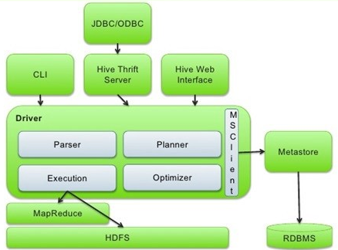
TECHNOLOGIES – Features & Limitations
Simple data warehousing solution for Hadoop(SQL-based distributed query engine)
Catalog of tables on top of HDFS (metastore) – shared with other technologies
Nested Structures and Multitenancy
Multiple Data Formats and storages supported
PL/SQL available
Notable recent perfomance improvements thanks to usage of query daemons (LLAP)
MapReduce is deprecated
Can execute queries also through Spark (HiveOnSpark)
JDBC Support
Apache Hive community: 186 contributors More than 120 commits the last 3 months
Could Hive fit in the desired architecture?
Hive is a standard for SQL structures in Hadoop
Hive for data processing: scales well on queries with large input sizes and with LLAP could improve also small datasets.
LLAP daemons eliminate the MapReduce overhead
(3rd layer) Presto, Drill and Spark can talk with hive data
Most likely we needed because of metastore
Mid-Query Fault Tolerance
Not designed for OLTP
Transactions supported for ORC format
Section Meeting - May 20, 2019 - Vasileios Dimakopoulos 15

Slide 16
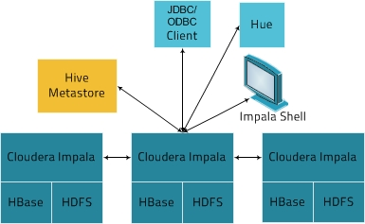
TECHNOLOGIES – Features & Limitations
Distributed SQL Query Engine
Supports HBase, HDFS, S3
Multiple Data Formats (Parquet, Avro etc.)
Low Latency – Exploits Hive’s Metadata
JDBC Support
Is Impala a good fit to data access layer?
Very fast for parquet and good response times
Effective resource utilization especially in terms of CPU
It performs well for small datasets
No Fault Tolerance
Query submission only via JDBC – no native connector from a higher level engine
No Fault Tolerance
Cannot query streaming data
Doesn’t support RDBMS
Lack of impersonation – all queries executed as service principal
Apache or Cloudera Impala’s community size: ≈ 100 contributors / More than 150 commits the last 3 months
Section Meeting - May 20, 2019 - Vasileios Dimakopoulos 16

Slide 17
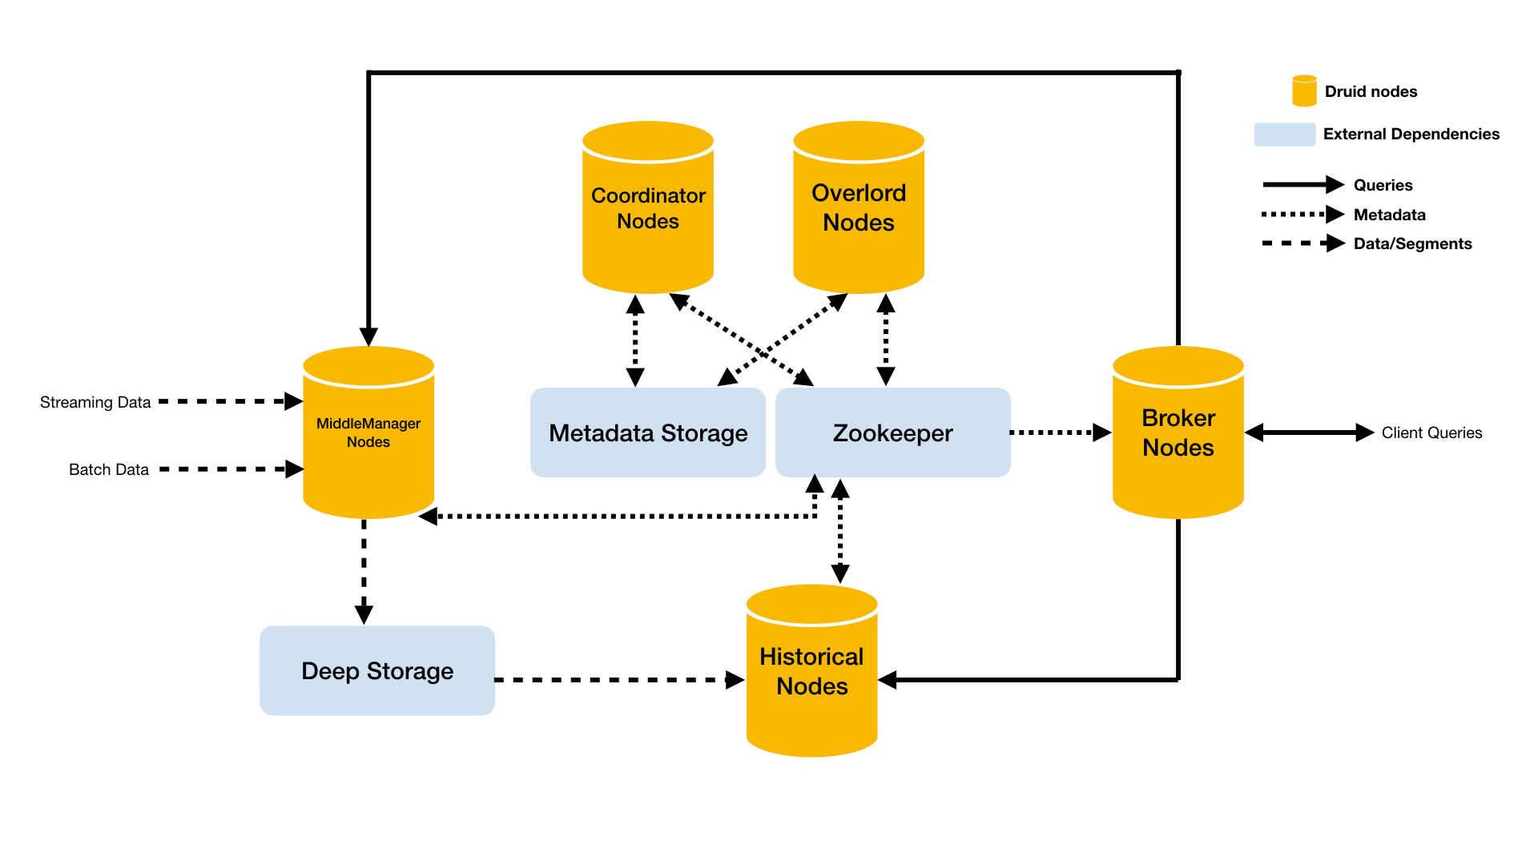
TECHNOLOGIES – Features & Limitations
High Performance Real Time Analytics Database on top of Kafka and HDFS
Real-time data served from memory
Older data form a column oriented storage in HDFS (not a Parquet or ORC)
SQL with JDBC support
Horizontal scalability and Fault tolerance
Complementary to Kafka, Hadoop, Flink etc.
Provides Cube speed OLAP querying
Can Druid fit to the architecture?
Druid can ingest data in real time from Kafka and query in real time all the data
It is yet another technology (interesting) for OLAP – quite closed architecture
It would add further complexity to the architecture (?)
No integration except JDBC
Doesn’t perform joins
Doesn’t support streaming updates
Huge variance in performance of historical nodes
Apache Druid’s community: 280 contributors More than 150 commits the last 3 months
Section Meeting - May 20, 2019 - Vasileios Dimakopoulos 17

Slide 18

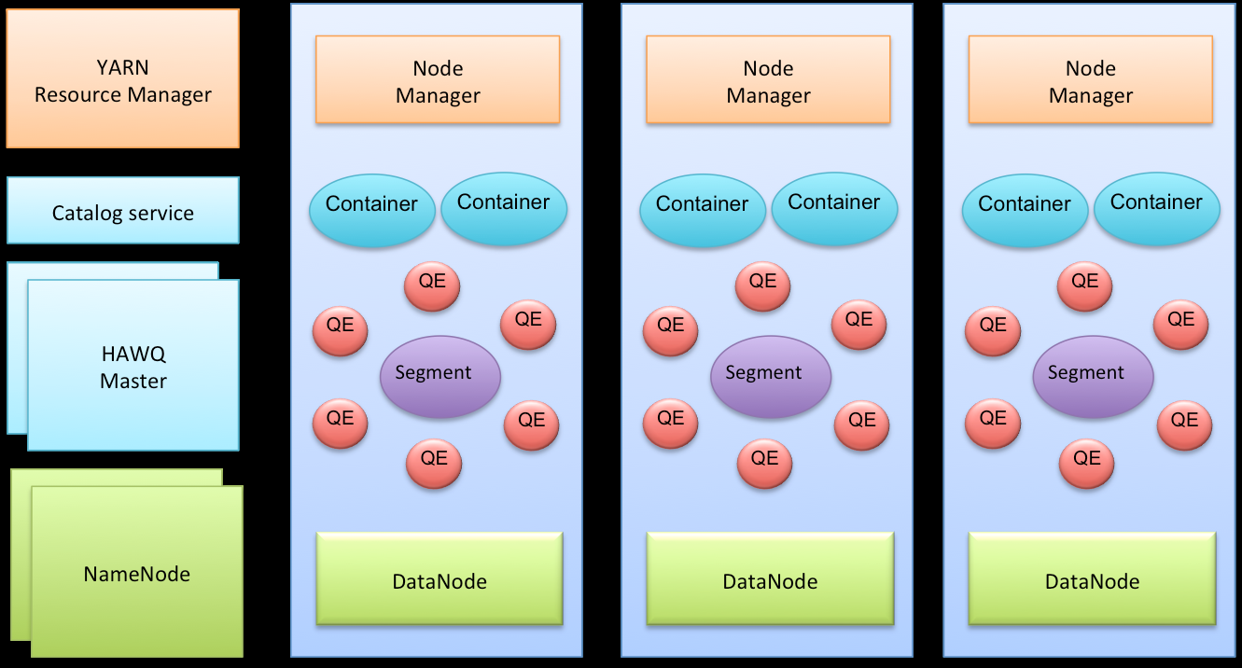
TECHNOLOGIES – Features & Limitations
Port of the Greenplum MPP Database
Query Engine which executes SQL on Hadoop
Parallel Processing – Low Latency
Compatible with Parquet, Avro, HBase etc.
Full Transaction Capabilities
JDBC support and Fault Tolerance
Supports various data stores
Apache HAWQ’s community: 71 contributors Less than 35 commits the last 3 months and 4 commits between Feb.2018 and Feb.2019
Is HAWQ a good fit?
It could be a considerable competitor to Impala, Hive or Spark for HDFS quering, therefore it might be a fast processing unit
Doesn’t have many connectors in order to integrate it in the Hadoop ecosystem →Can’t be used easily neither as middleware nor as top tier technology
Multi-language user defined function support: Python, Perl, Java, C/C++, R
Does not use Hive – catalog on HDFS
Relatively small number of contributions & commits
Section Meeting - May 20, 2019 - Vasileios Dimakopoulos 18

Slide 19
ARCHITECTURE
SQL
Data Storage Layer
Data Access Layer
Top Abstraction Layer
Section Meeting - May 20, 2019 - Vasileios Dimakopoulos 19

Slide 20
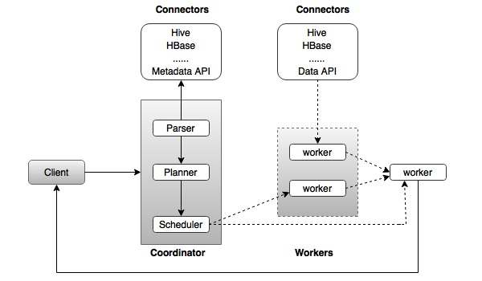
TECHNOLOGIES – Features & Limitations
Presto is one of the strongest candidates !
Distributed SQL Query Engine
Supports many data stores and data formats
Optimal for interactive analysis
JDBC driver and Multitenant
Sub-Second to Minute response time
Can combine data from multiple sources
Why Presto is good candidate?
Previous presto benchmarking during openlab summer program showed a good performance and promising compatibility with the existing frameworks
Have many connectors including Hive, Phoenix (MR), Postgres, MySQL, Kafka etc
Ease of use which renders it as a good user friendly option
No fault tolerance
No PL/SQL
User defined functions are not available
Presto’s community: 284 contributors/≈ 300 commits the last 3 months
Section Meeting - May 20, 2019 - Vasileios Dimakopoulos 20

Slide 21
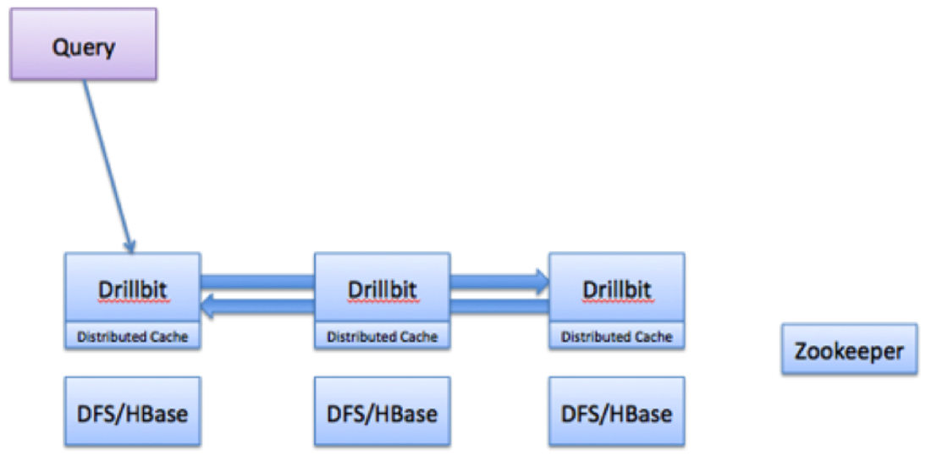
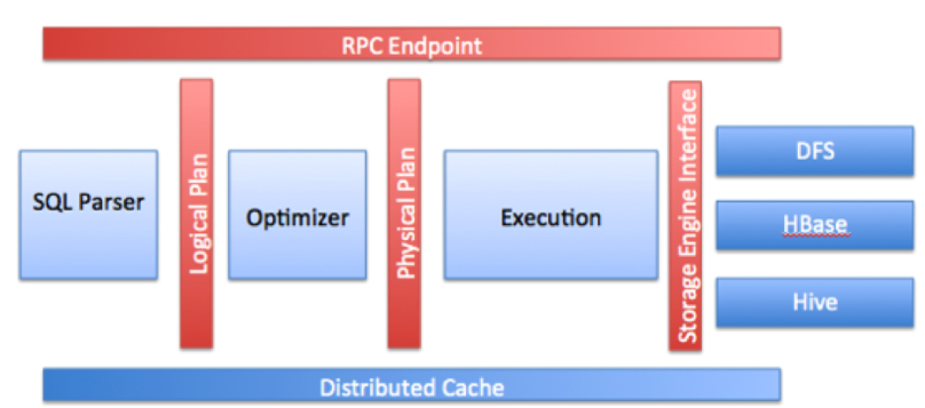
TECHNOLOGIES – Features & Limitations
Drill is another strong candidate!
Distributed Query Engine – Fault tolerant
Supports many data stores and interfaces to them
No overhead in query execution
Exceptional scalability and elimination of Garbage collection
It is built on Calcite to do query parsing and optimization
JDBC driver with support for multiple users
Supports nested data as well as rapidly evolving structures
Why Drill is a fit to the top layer?
It shares same features with Presto which makes it a good competitor
It uses Apache Arrow for In-memory computations
Does not need Hive metastore to query data on HDFS
Throttling functionality may limit the concurrent queries
It doesn’t require schema definition which could lead to struggling with malformed data
Performance is optimal for Parquet and thus other formats’ performance need to be evaluated
Drillbit:
Apache Drill’s community :124 contributors/ More than 100 commits the last 3 months
Section Meeting - May 20, 2019 - Vasileios Dimakopoulos 21

Slide 22
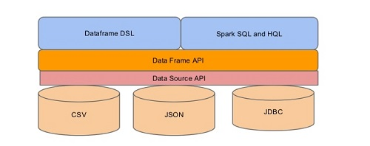
TECHNOLOGIES – Features & Limitations
Distributed Query Engine
Avoids the overhead of MR jobs. Basically it leverages the benefits of spark execution velocity.
Supports JDBC as well as Hive metastore and multiple data formats and UDFs
Caching is efficient since Dataframes are aware of column type
Why SparkSQL could be a top layer engine?
Can query directly a lot of different storages (reach connectors set)
Ensures a user friendly environment which supports a wide range of workloads such as batch queries, iterative algorithms, interactive queries, streaming etc.
Average dynamic resource management.
Thrift Server seems to be quite limited in functions? (TBT)
Hive transactions are not supported by SparkSQL
No support for real time processing
Huge Community > 1300 contributors & more than 400 commits the last 3 months
Section Meeting - May 20, 2019 - Vasileios Dimakopoulos 22

Slide 23
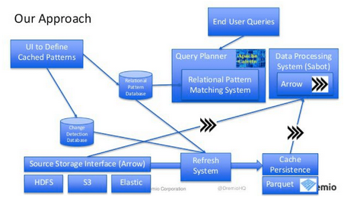
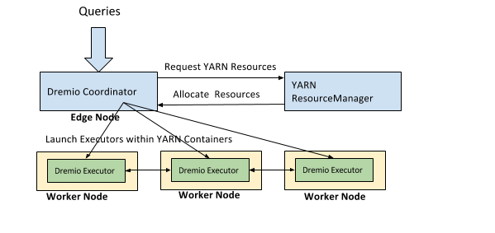
TECHNOLOGIES – Features & Limitations Built on top of Arrow, Calcite and Parquet
Memory-based BI query engine (Data as a service)
Startup from 2017 – quite new
Comes with future-reach Web-UI
Advanced query push down and interactive speed queries
Supports NoSQL databases as well as HDFS, S3, RDBMS & HBase
Read/Write statements are supported
Nested structures
Why Dremio could serve as top layer query engine?
High compatibility with the existing Big Data infrastructure
Seems to be a ready-to-use solution
Doesn’t support Kafka yet
There might be challenges with raw unstructured or complex data
Small community but supported by the developers of the built-in elements (Arrow, Calcite & Parquet)
Section Meeting - May 20, 2019 - Vasileios Dimakopoulos 23

Slide 24
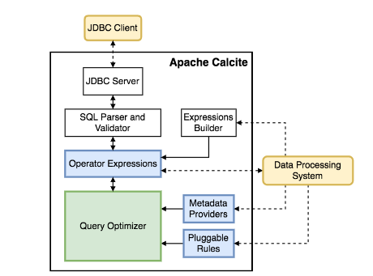
TECHNOLOGIES – Features & Limitations
Query engine and optimization through a cost model – Dynamic Data management framework
Storage technology agnostic
Connect to a bunch of data sources
JDBC support
High Reliability incorporating test suite which validates the components of the system
Incorporates relational cache
Why Calcite is a good abstraction?
Proviedes top abstraction layer with JDBC
Builds a relational cache
Could incorporate any data format through a simple CSV adapter file
Doesn’t incorporate a repository for metadata
Query optimization affect join optimization and therefore the performance depends on table sizes and join order
Many query engines incorporate Apache Calcite and therefore it could be omitted.
Apache’s Calcite community: 185 contributors/ almost 80 commits the last 3 months
Section Meeting - May 20, 2019 - Vasileios Dimakopoulos 24

Slide 25


Shortlist of technologies to be further explored
Top Abstract - 3rd layer
Presto, SparkSQL, Drill, Dremio, Calcite*
Data Access - 2nd layer
Phoenix, Trafodion, Hive with LLAP, Impala, SparkSQL, Presto, Drill
Data Storage - 1st layer
ORC, Hudi
Section Meeting - May 20, 2019 - Vasileios Dimakopoulos 25

Slide 26
PLAN FOR THE EVALUATION OF THE TECHNOLOGIES
Generic SQL layer: Drill vs Presto vs SparkSQL vs Dremio
If no obvious candidate we will try Apache Calcite
Spark JDBC thirft service and its performance to be evaluated
Data access layer:
HDFS: Hive vs Impala vs Presto vs Drill vs Spark
HBase: Hive vs Impala and Phoenix vs Trafodion vs Spark
Kafka: Presto vs Drill vs Spark
RDBMS: Presto vs Spark vs Drill?
Data storage
HDFS formats: ORC vs Parquet vs Hudi
Does the interoperation between technologies of data access and abstraction layer is good enough (complexity, performance)?
The candidate technologies will be installed on a test cluster with security features enabled
Key aspects: usablity, performance, security, simplicity, availability, users impersonation
As test datasets we plan to use:
TPC-DS (general pourpose analytics), NXCALS (data extraction on nested structures), EventIndex (data lookups) and WinCCOA( for RDBMS access)
Section Meeting - May 20, 2019 - Vasileios Dimakopoulos 26

Slide 27
Conclusions - Summary
Short list of technologies prepared
2 vs 3 layers – genericity vs specialization
It is not possible to decide at the current stage what stack fits best
We found few very good candidates for 2nd and 3rd layer
Further evaluation needed
Some trends observed
A lot of projects started on SQL on Hadoop within 2012-2017
Some of projects seems to be not very active anymore
Some technologies offering full OLAP solutions on top of Hadoop – we cross them out
Though, they could be interesting for certain use cases
Section Meeting - May 20, 2019 - Vasileios Dimakopoulos 27

Slide 28
Conclusions - Summary
This project aims at simplifying the data querying process and unification of the data analysis through different data stores
To achieve this, we need one or two layers to be constructed on top of the data storage layer.
There will be evaluation of candidate technologies to choose the one which fulfill the aspects set.
The foreseen architecture should be able to incorporate pluggable elements as well as scalable technologies.
Future steps :
Runing further evaluation on shortlisted set of technologies on test clusters (hadoop3 and hadalytic)
Selecting the best candidates and designing the system
Implementing a prototype
Section Meeting - May 20, 2019 - Vasileios Dimakopoulos 28

Slide 29
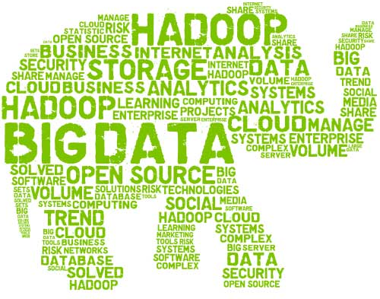

THANK YOU
Link to technologies comparison
vasileios.dimakopoulos@cern.ch

